Slide 1
Build Cross-Platform Apps with Ionic & Angular
Selva Prasath Selvamani
Lead Software Engineer

Slide 2
The Cross-Platform Challenge
Separate codebases = costly
Native apps vs. web apps tradeoffs
Need for efficiency → “write once, run anywhere”

Slide 3
What is Ionic
Open-source UI toolkit for cross-platform apps
Runs with Angular, React, Vue, or plain JavaScript
Features:
100+ prebuilt UI components
Capacitor (native bridge)
Theming + adaptive design
Works across iOS, Android, Web, Desktop

Slide 4
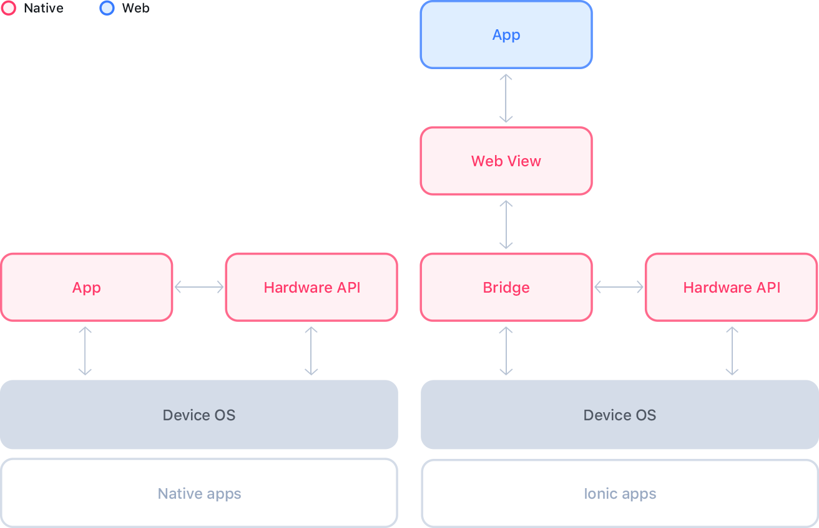

Slide 5
Why Angular + Ionic?
Angular = structured, opinionated, enterprise-friendly
Ionic leverages Angular’s ecosystem (RxJS, Forms, Routing)
Mature community + tooling support
Familiar for web developers → faster learning curve

Slide 6
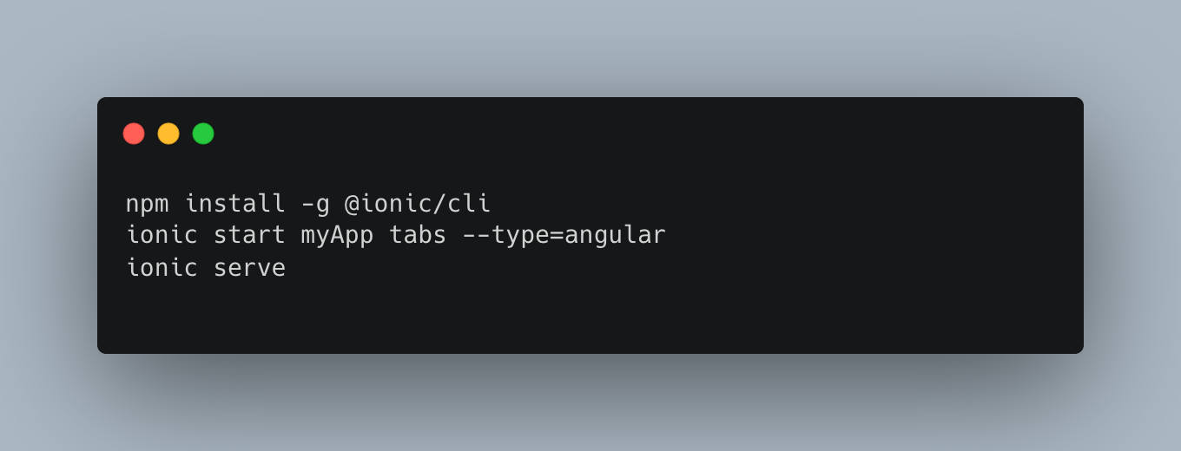
Setup Workflow
Install Ionic CLI
Generate a project with Angular template
Project structure overview
Live reload & dev server

Slide 7
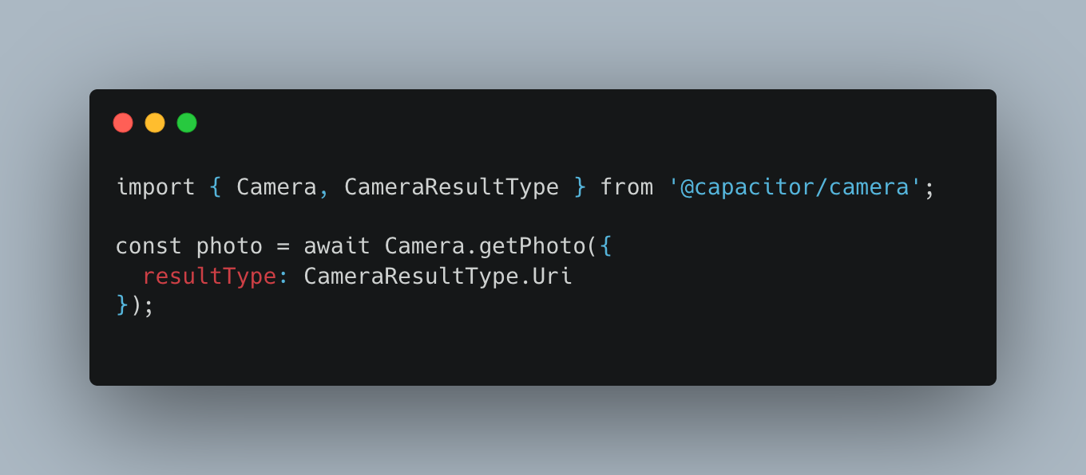
Native Device Access with Capacitor
Capacitor = bridge to native APIs
Examples:
Camera
Geolocation
Notifications
Demo snippet: using Camera API

Slide 8
Deployment Workflow
Run as PWA → ionic build
Mobile (iOS/Android) → Xcode/Android Studio builds
Desktop (Electron + Ionic)
Cloud deployment options

Slide 9
Live Demo
Start a project
1
Add a UI component
2
Access device API (e.g., camera or geolocation)
3
Run in browser and preview mobile

Slide 10
When to Choose Ionic + Angular?
Best when:
Team already knows Angular
You need one codebase across platforms
Rapid prototyping and enterprise apps
Consider alternatives if:
Heavy performance needs (3D gaming, complex animations)

Slide 11
Summary
Ionic + Angular = efficient cross-platform dev
Workflow: Setup → Build UI → Add native access → Deploy
Huge productivity boost for Angular devs

Slide 12


. Q&A

